Slide 1



Admin Training
Items and Bills of Materials

Slide 2
Learning Objectives Items and Bills of Materials
Teach
(Slides)
Show
(Demo)
Do
(Exercises)
Review
(Q&A)
Items & BOMs Overview
Creating Items / Creating BOMs
Part Numbering
Categorization (Classification)
Creating BOM Fields and BOM Views
Importing & Exporting

Slide 3
1 – Items & BOMs Overview

Slide 4
BOM Overview
What is a Bill of Materials?
A list of the raw materials, sub-assemblies, intermediate assemblies, sub-components, parts and the quantities of each needed to manufacture an end product. A BOM may be used for communication between manufacturing partners, or confined to a single manufacturing plant.
A BOM is also known as the formula, recipe, or ingredients list.

Slide 5
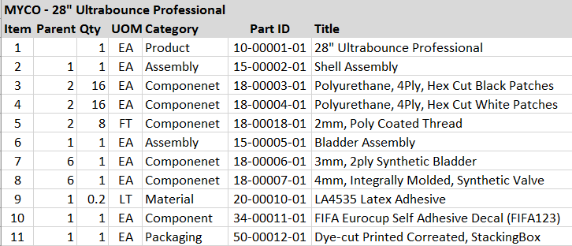

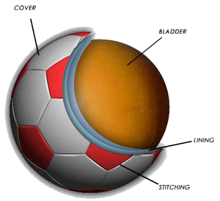
Example Bill of Materials

Slide 6
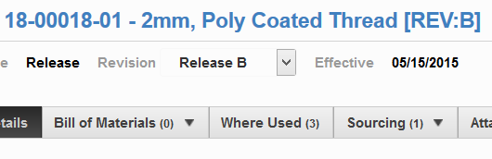
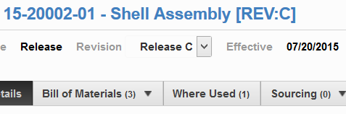
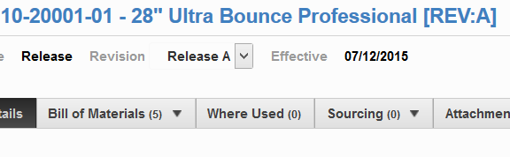
Items and BOMs Coexist
The sub-assemblies and parts reside in the same workspace as the top level assemblies.
If an item has Where Used entries and no BOM entries, it is a bottom-level part.
If an item has Where Used entries AND BOM entries, it is a sub-assembly.
If an item has no Where Used entries and BOM entries, it is a top-level assembly.
“Leaf”
“Branch”
“Root”

Slide 7
2 – Creating Items / Creating BOMs

Slide 8
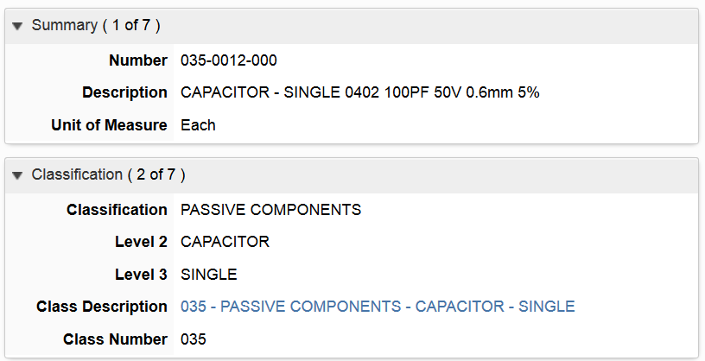
Creating Items
Part numbers generated from classification entered
Filtered picklists reach into the Classification workspace
Tips
To change the upper fields, clear out the lower fields of the picklist entries

Slide 9
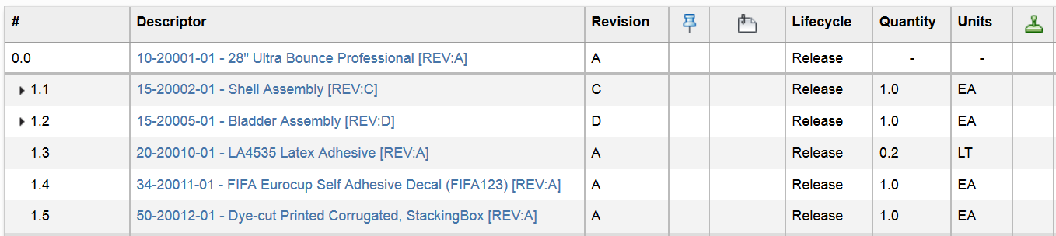
Creating a BOM
Add items to one level of a BOM at a time
Specify quantity for each item
Edit BOM-only fields like quantity, revision pinning, and BOM order
Tips
Use the Preview Card to quickly move between items and expedite editing them!

Slide 10
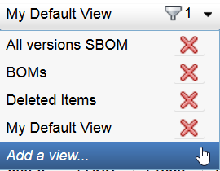
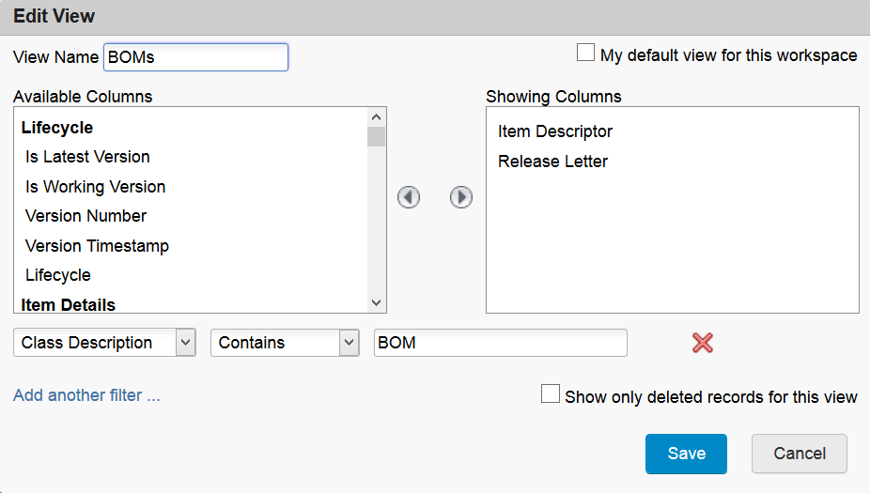
Add / Edit Views in Item Viewer
Report-like capabilities of Views
Drag and drop columns to display
Sort by any field
“Funnel” shows how many filters are on this view
Tips
Always leave My Default View alone and modify new ones that you create

Slide 11
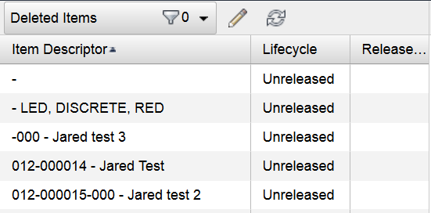

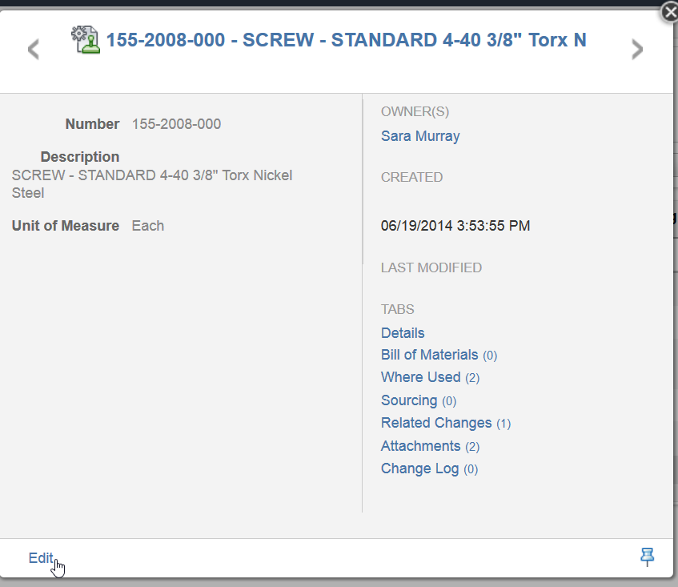
Teach
(Slides)
Show
(Demo)
Do
(Exercises)
Review
(Q&A)
Demo Topics Items & BOMs Overview
Navigating
Create New Views in Item Viewer
Preview Card on BOMs
Flat / Expanded View of BOM
Creating Items
Categorization (Classification)
Filtered Pick Lists
Attachments
Creating BOMs
BOM Tab
One level at a time
Clone zz_Items & BOMs 2 Workspace
Add a pick list field

Slide 12
Exercises 1 - 8
Teach
(Slides)
Show
(Demo)
Do
(Exercises)
Review
(Q&A)

Slide 13
3 – Creating BOM Fields and Views

Slide 14
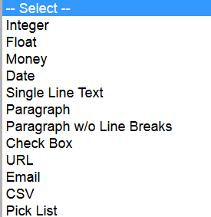
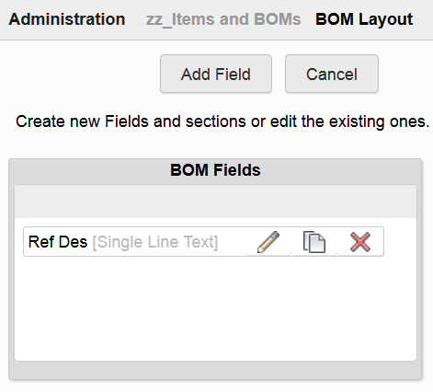
Creating a BOM Field
Subset of field types is available
Only resides on the BOM

Slide 15
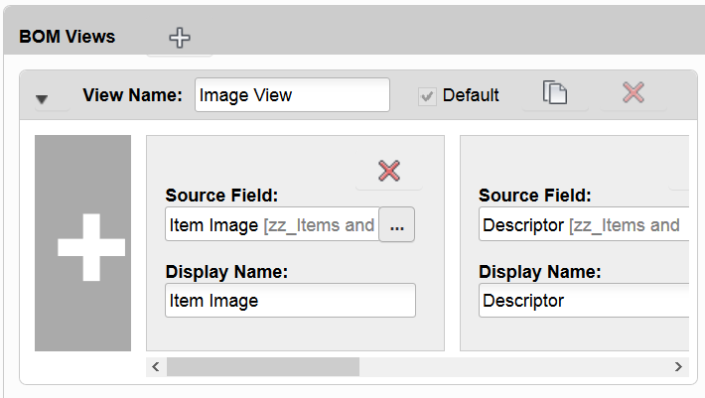
Creating a BOM View
Can only be done by an administrator
Can pull from custom BOM fields OR from other tabs
Item Details
System Fields
Sourcing Fields
Immediately pushed out to all users as an option
Tips
Clone a BOM View for similar views
Create fields on the BOM View the furthest-right ones first
Zoom the browser in as needed to speed dragging fields to their destination in the BOM View

Slide 16
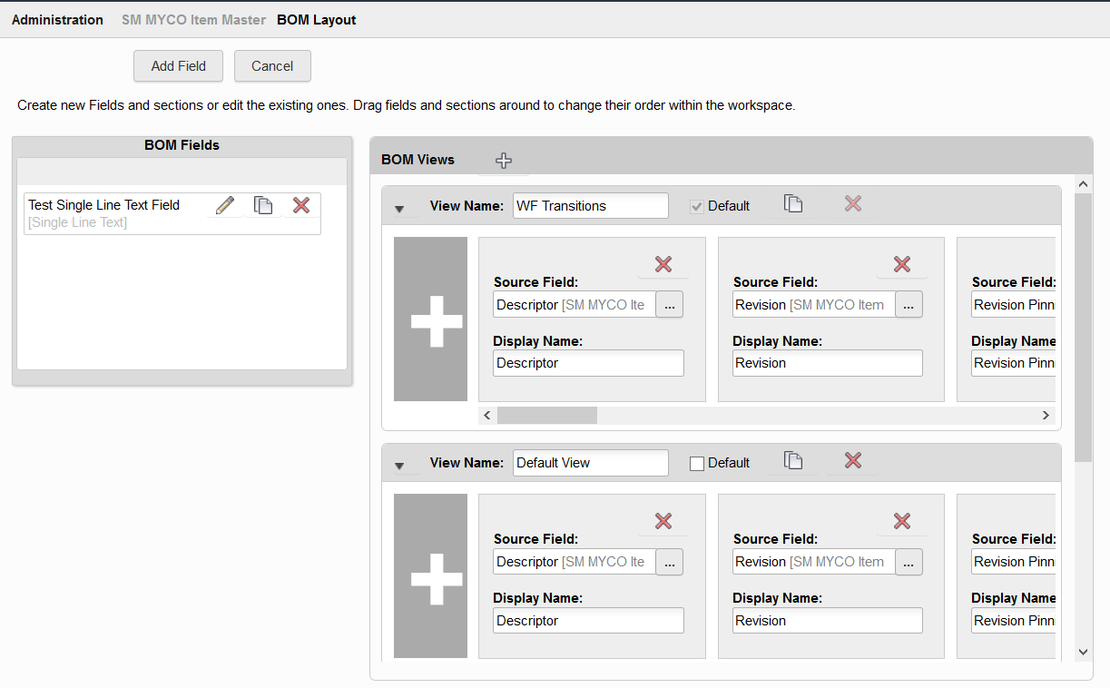
Teach
(Slides)
Show
(Demo)
Do
(Exercises)
Review
(Q&A)
Demo Topics Creating BOM Fields and Views
Creating a BOM Field
Cloning a BOM View

Slide 17
Exercise 10
Teach
(Slides)
Show
(Demo)
Do
(Exercises)
Review
(Q&A)

Slide 18
4 – Importing and Exporting

Slide 19
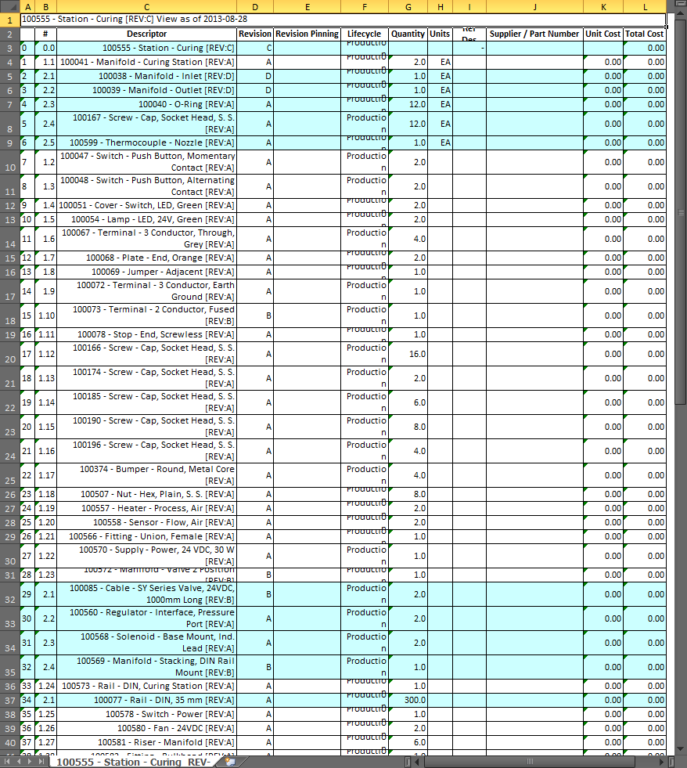
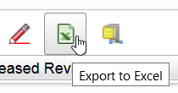
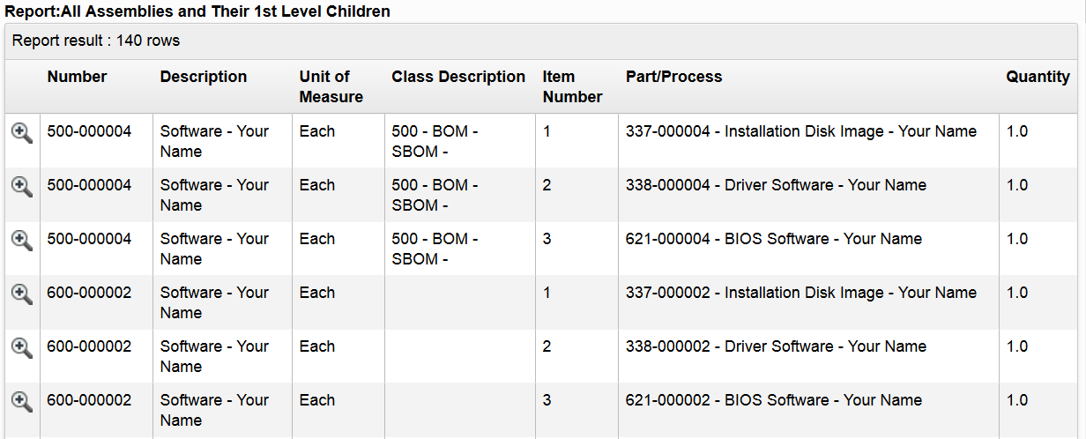
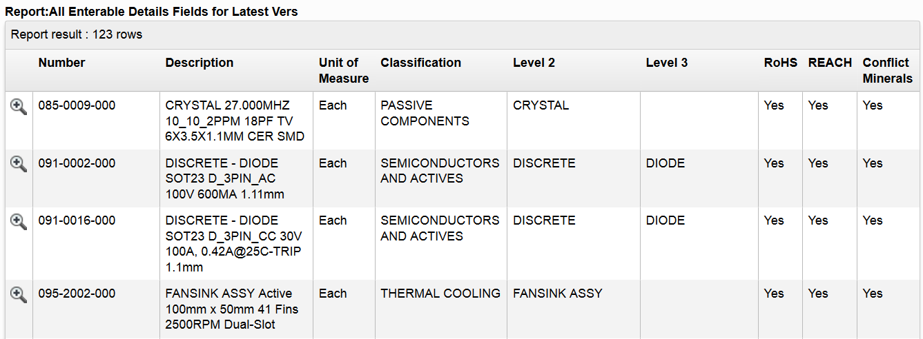
Methods of Exporting
Export to Excel from BOM
Export BOMs via Report
Export Item Details via Report
Notes:
Report: All Assemblies and Their 1st Level Children is in LYT training

Slide 20
Export to Excel from BOM
Bill of Materials Tab
Click Export to Excel
Zip and Download

Slide 21
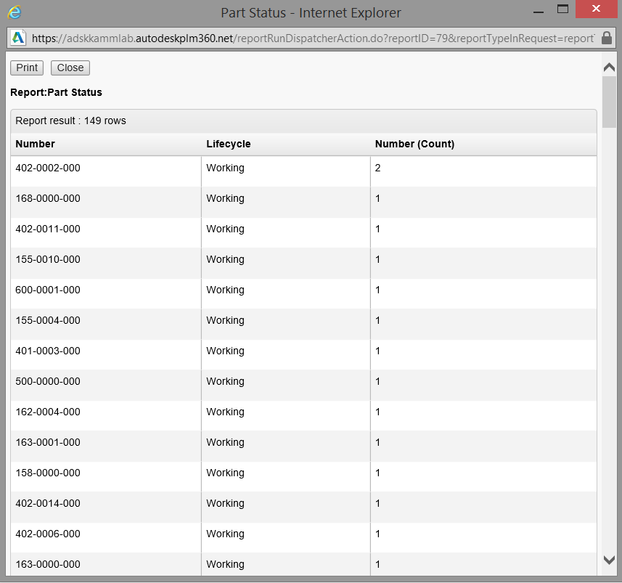
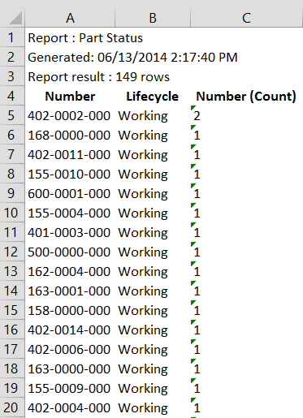
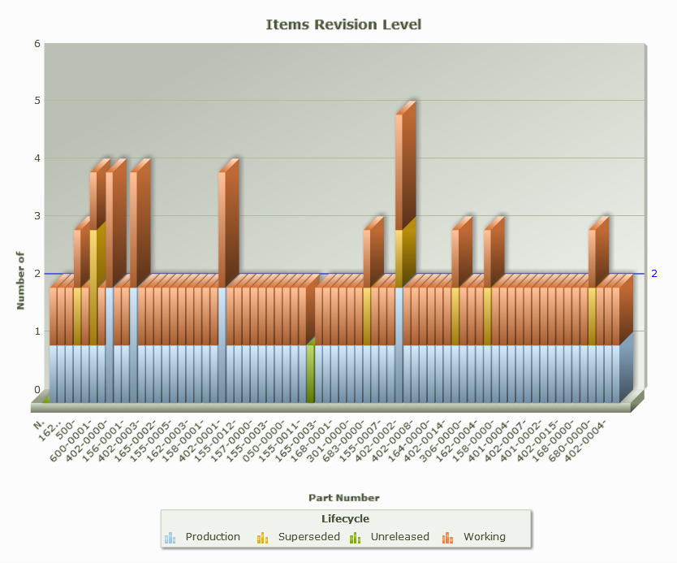
Running Reports
HTML
Run and output the report as an HTML file.
Excel
Run and output the report as a Microsoft Excel file.
Chart
Run and output the report as a chart. This option is available only if a chart is created for the report.

Slide 22
Exercise 11
Teach
(Slides)
Show
(Demo)
Do
(Exercises)
Review
(Q&A)

Slide 23
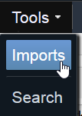
Importing
Input is an Excel spreadsheet
First row must be column headers
Automatically matched to field names if values are the same
One import project per spreadsheet
Target is a single workspace
Import Types:
Item Details
Parent Child BOM
Hierarchy BOM
Level BOM

Slide 24
Built-In Import Tool
Available Functions:
Mass Import
Mass Update
Mass Delete
Requirements:
Limit each import project to 40,000 lines
Limit each import project to 5,000 lines when importing BOM relationships or updating data, due to heavy key matching process
Tips
You can import from an exported report, but you must Save As .XLSX first

Slide 25
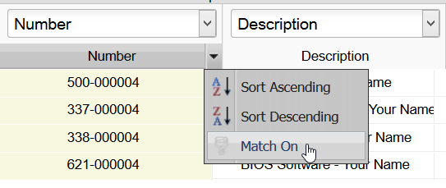

Column Mapping & Settings
Check system mappings
Add manual mappings if needed
For Mass Update:
Locate the “Match On” key in the drop down next to the input column name
Toggle the key On
Same for Mass Delete
Same for BOM relationships creation

Slide 26
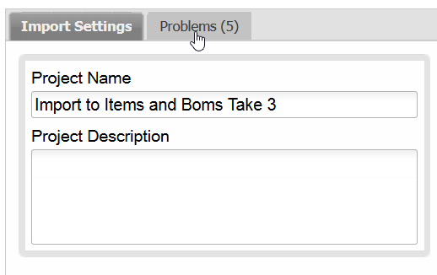
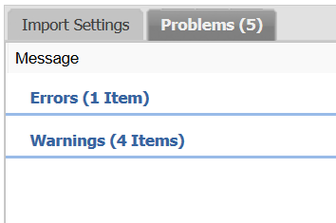
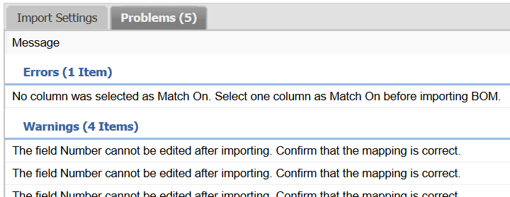
Addressing Problems in Import Project
After Save, check “Problems” tab
Warnings can be ignored
Errors keep import from proceeding
Modify settings and try again!
For more info:
https://razorleaf.com/2015/09/import-legacy-items-boms-into-autodesk-plm-360-with-revisions/

Slide 27
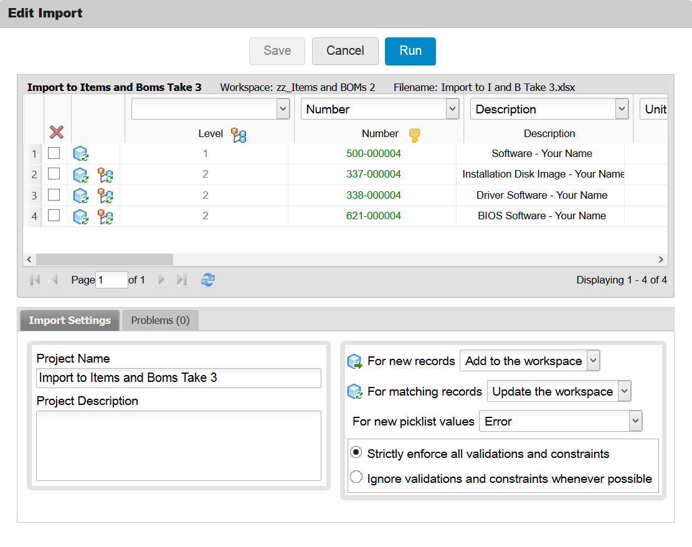

Teach
(Slides)
Show
(Demo)
Do
(Exercises)
Review
(Q&A)
Demo Topics Importing
Built-In Import Tool
Import Released Items

Slide 28
Exercises 12 - 13
Teach
(Slides)
Show
(Demo)
Do
(Exercises)
Review
(Q&A)

Slide 29
Review Items and Bills of Materials
Teach
(Slides)
Show
(Demo)
Do
(Exercises)
Review
(Q&A)
Items & BOMs Overview
Creating Items / Creating BOMs
Part Numbering
Categorization (Classification)
Creating BOM Fields and BOM Views
Importing & Exporting

